Slide 1


Building a MATE Floats! Vertical Profiler

Slide 2



Educational Resources are licensed under a
Creative Commons Attribution-NonCommercial-ShareAlike 4.0 International License.
Based on work at www.materovcompetition.org/rov-kits
Under this license you may download, modify, and share this presentation. Please give credit to MATE for this content. We ask that you do this by retaining this slide and the slide background. You may not use these materials for commercial purposes without written permission from MATE. Please click on the Creative Commons link above for license details.
This material is based upon work supported by the National Science Foundation to the Marine Advanced Technology Education (MATE) Center under Grant Numbers DRL/ITEST 1312333 and DUE/ATE 1502046, with contributions from the National Center for Autonomous Technologies (NCAT) NSF/DUE 1902574 subaward to MATE Inspiration for Innovation.
Any opinions, findings, and conclusions or recommendations expressed in this material are those of the author(s) and do not necessarily reflect the views of the National Science Foundation.
The Marine Advanced Technology Education (MATE) Center was established with funding by the National Science Foundation via a grant to Monterey Peninsula College in 1997. Founded in 2016, MATE Inspiration for Innovation (MATE II) was a 501(c)3 non-profit organization inspired and created by the MATE Center to support and sustain educational activities initiated at the Center. On July 1, 2023, MATE II and its programs, products, and services were integrated into the Marine Technology Society. While the MATE organization has evolved over time, its mission remains the same - to to inspire and challenge students to learn and creatively apply science, technology, engineering, and math (STEM) to solving real-world problems in a way that reinforces critical thinking, collaboration, entrepreneurialism, and innovation.
Notes:
SeaMATE kits

Slide 3
MATE Floats! Vertical Profiler
The MATE Floats! Vertical Profiler is not a true float, it is a simple kit intended to introduce SCOUT and NAVIGATOR teams to the idea of designing and building a vertical profiling float and help them to complete the MATE Floats! Task. MATE Floats! Vertical Profiler – SeaMATE
The MATE Floats! Vertical Profiler kit has a power cord kit, a switch for controlling the float, a tether, and a single motor to move the profiler up and down in the water column. Extra wires in the tether can be used to connect a temperature sensor from the profiler to the surface.
This presentation provide basic instructions for assembling the Profiler kit.
Notes:
I need a volunteer. You are going to hold an ROV and complete a task. I want a close up picture of something in the room.
What movements did the ROV make

Slide 4
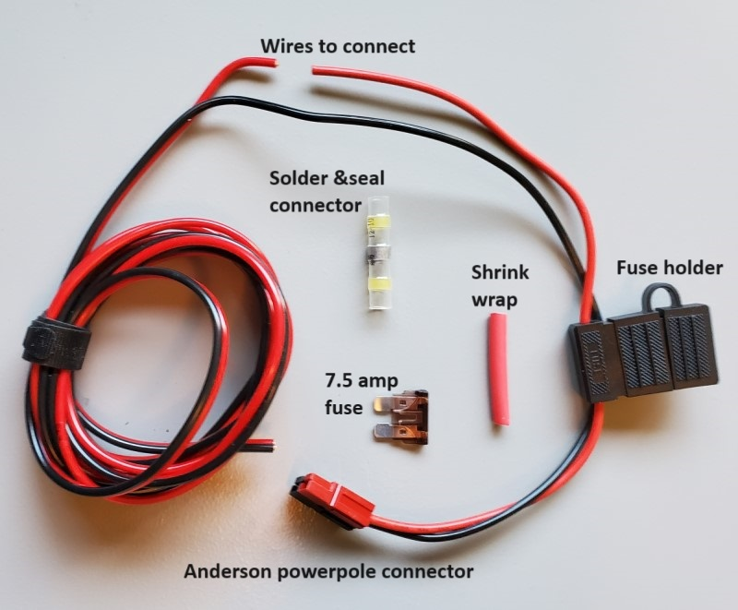
Profiler - Power Cord
The MATE Floats! Vertical Profiler kit comes with a power cord to bring power to the control switch.
If you choose to use the solder & seal connector to complete your Profiler power cord, use the AngelFish: Creating your Power Cord presentation.
If you choose to solder and waterproof your connection with hot glue and shrink wrap, use the PufferFish: Creating your Power Wire presentation.
Use the 7.5 amp fuse provided in the profiler kit instead of the 10 amp fuse shown in the presentations.
Notes:
I need a volunteer. You are going to hold an ROV and complete a task. I want a close up picture of something in the room.
What movements did the ROV make

Slide 5
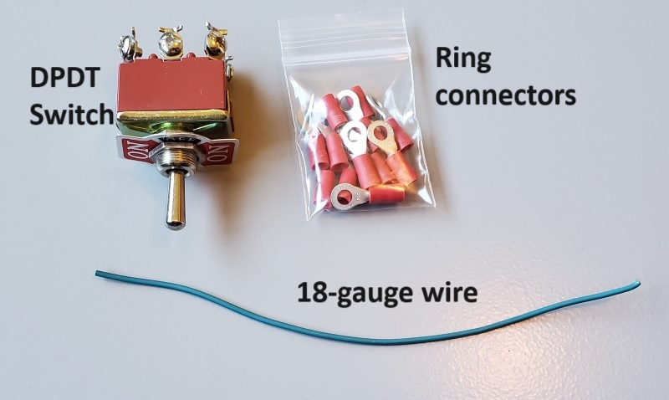
Profiler - Control
The control system consists of a DPDT switch, a length of 18-gauge wire (color will vary), and terminal ring connectors.
The MATE Floats! Vertical Profiler kit does not provide a box to mount the switch to.
You are free to choose or design a box that fits comfortably in your hands and can mount the switch. Here is an example of an inexpensive simple box that can be used: Electrical box
Notes:
I need a volunteer. You are going to hold an ROV and complete a task. I want a close up picture of something in the room.
What movements did the ROV make

Slide 6
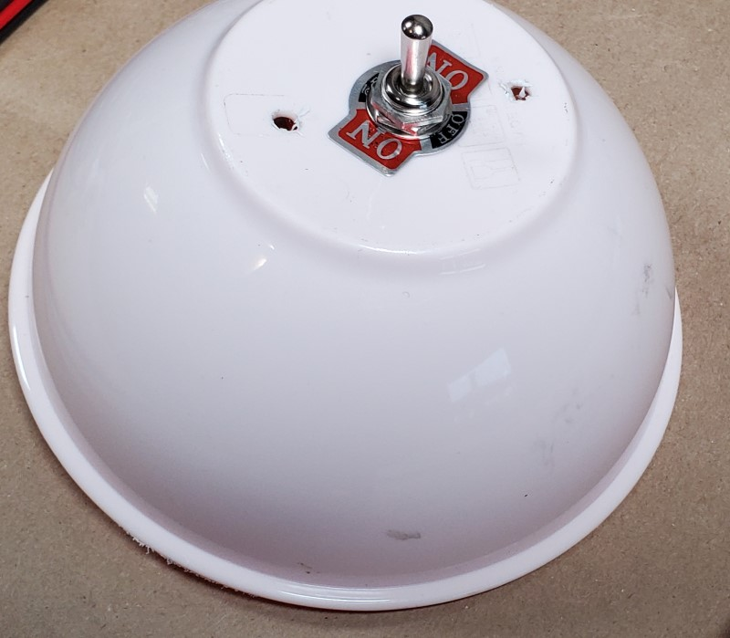
Profiler - Control
Another option for the control box is a plastic bowl. The plastic bowl seen below was a coral from the 2023 MATE ROV Competition mission.
The switch is mounted to the bowl. The power cable and tether can pass through the sides or through the lid of the bowl. See instructions on the follow slide for creating your control box.
Notes:
I need a volunteer. You are going to hold an ROV and complete a task. I want a close up picture of something in the room.
What movements did the ROV make

Slide 7
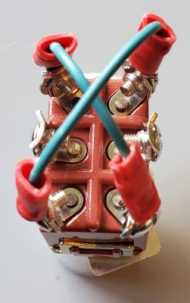
Profiler - Control
Want to learn more about how a DPDT Switch works? See the How a Switch Works presentation.
Detailed instructions for building your control box can be found in the Creating the Profiler Control System presentation. This presentation covers:
Mounting the switch in the control box
Creating an “X” on the back of the switch
Bringing in power to the switch
Instructions for attaching the tether to the switch are included in the next section of this presentation: Profiler - Tether.
Notes:
I need a volunteer. You are going to hold an ROV and complete a task. I want a close up picture of something in the room.
What movements did the ROV make

Slide 8
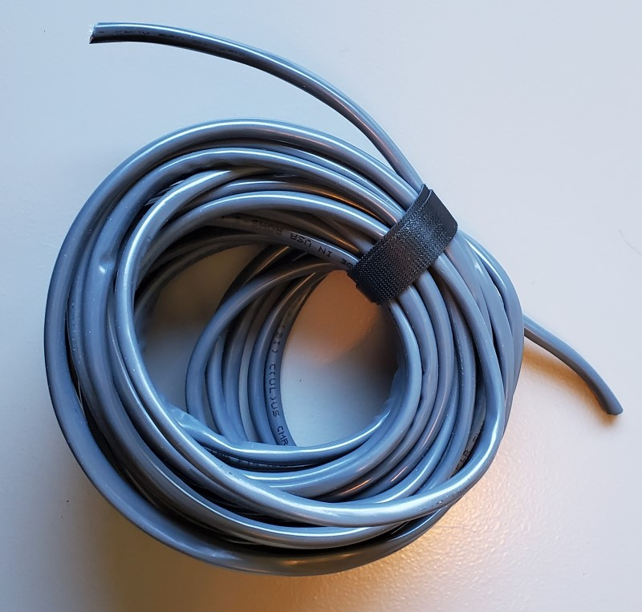
Profiler - Tether
The tether system consists of a 7.6 meter (25 foot) length of six 18-gauge wires. The single motor will use two of the six wires. The temperature sensor can use two other tether wires (optional). (Two wires will be not be used for the basic profiler build.)
Notes:
I need a volunteer. You are going to hold an ROV and complete a task. I want a close up picture of something in the room.
What movements did the ROV make

Slide 9
Profiler - Tether
Choose two colors of wire to power the thruster motor. The standard MATE colors for vertical motors is blue and brown (blue and brown - up and down), but any two colors can be used.
See the Profiler: Connecting the Tether to the Control Box presentation for instructions on connecting the tether to the control box.
Notes:
I need a volunteer. You are going to hold an ROV and complete a task. I want a close up picture of something in the room.
What movements did the ROV make

Slide 10
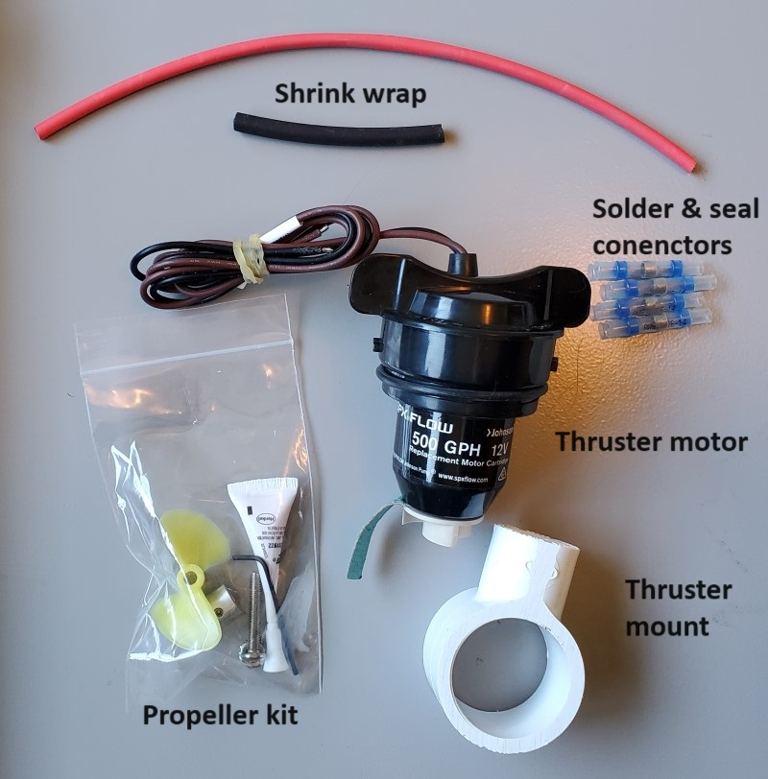
Profiler - Propulsion
The propulsion kit consists of a thruster motor, a PVC motor mount, a 1-propeller kit, shrink wrap, and four blue solder & seal connectors.
You will need to:
Insert the thruster motor into the thruster mount.
Mount the propeller on the motor.
Connect (waterproof connection) the thruster motor to the tether.
Notes:
I need a volunteer. You are going to hold an ROV and complete a task. I want a close up picture of something in the room.
What movements did the ROV make

Slide 11
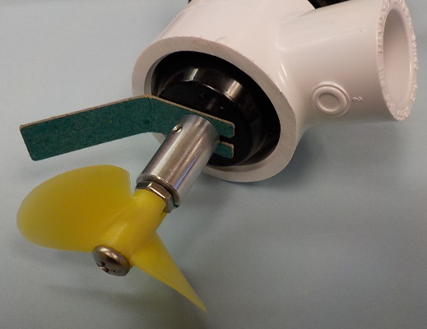
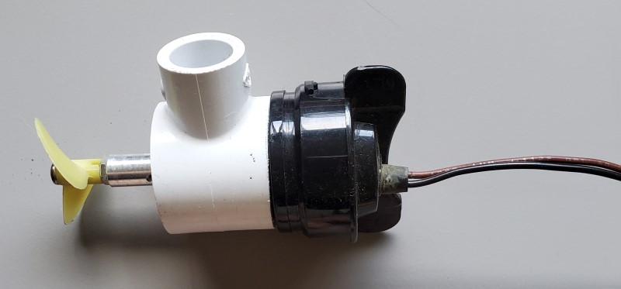
Profiler - Propulsion
To install the thruster motor mount over the motor and attach the propeller to the thruster motor, use the Motors and Propellers presentation. Just note that you will be working with only one motor, not three motors.
To connect the motor wires to the tether using either solder & seal connectors or a soldering iron use the Profiler: Connecting the Tether to the Motors presentation.
Notes:
I need a volunteer. You are going to hold an ROV and complete a task. I want a close up picture of something in the room.
What movements did the ROV make

Slide 12
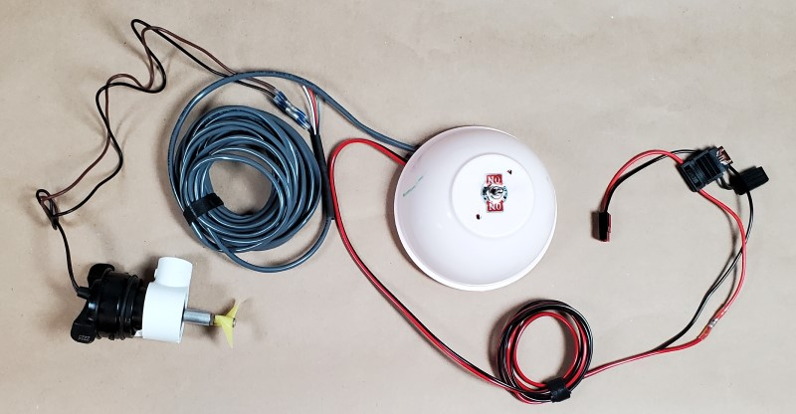
Profiler
At this point, the MATE Floats! Vertical Profiler should be ready to go. To verify operation, connect the profiler to power (using the Anderson powerpole connector). Then test to verify that your switch is able to turn the propeller in two directions.
Notes:
I need a volunteer. You are going to hold an ROV and complete a task. I want a close up picture of something in the room.
What movements did the ROV make

Slide 13
Profiler - Frame
Frame design is up to you, but the thruster motor mount will connect to ½-inch PVC pipe. You will want the motor (ballast) at the bottom, and foam flotation at the top (countering the weight of the motor and frame). See the ROV Buoyancy presentation for more on ballast, buoyancy and balancing the two out to make your float neutrally buoyant.
Remember:
Your propeller must be shrouded or protected inside the PVC frame (this will be more difficult on a profiler than on the ROV).
Your profiler may only be 50 cm in height.
Notes:
I need a volunteer. You are going to hold an ROV and complete a task. I want a close up picture of something in the room.
What movements did the ROV make

Slide 14
Profiler - Temperature Sensor
To complete the MATE Floats! mission, you will need to add a temperature sensor to your profiler to record temperatures in the air, at the surface of the pool, midwater in the pool, and at the bottom of the pool.
The Sensors presentation is an introduction to simple sensors, including a temperature sensor. If you plan on using the simple Resistance Temperature Detector (RTD) shown in the presentation, you can use two tether wires to extend the RTD. In the instructions for extending the length of wires of your RTD (step #5), just choose two colors of wire in your Profiler tether as you wire extensions. Use the solder & seal connectors or a soldering iron to make the wire connections.
Notes:
I need a volunteer. You are going to hold an ROV and complete a task. I want a close up picture of something in the room.
What movements did the ROV make

Slide 15
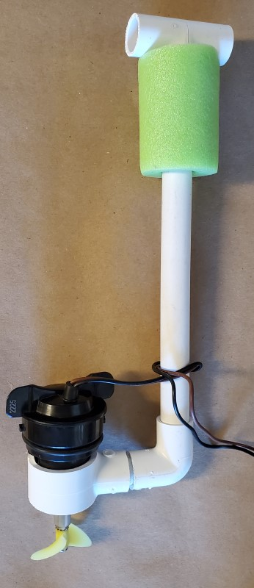
Profiler - Completed
At this point, you should have a profiler that can descend and ascend in the pool (make sure your motor is oriented so it moves the profiler vertically). The probe end of the temperature sensor can be attached (tape, cable tie, etc.) to the frame, with the readout on the surface.
Dive in and test it out!
SeaMATE Store link: MATE Floats! Vertical Profiler
Profiler shown without motor shroud and without temperature sensor
Notes:
I need a volunteer. You are going to hold an ROV and complete a task. I want a close up picture of something in the room.
What movements did the ROV make

